Slide 1
Machine Learning
South Fayette Pilot

Slide 2
Recap:
We’ve learned both the:
Weighted Majority Algorithm. WMA can look at multiple aspects of data and combine them. WMA can also learn incrementally as new data comes in.
K- Nearest Neighbors. KNN can map continuous variables in multiple dimensions and has a distance measurement between datapoints
Selling your idea

Slide 3
Some Biology Background:
Genes are a basic physical unit of heredity consisting of a linear sequence of nucleotides along a DNA segment.
Genotype is the genetic makeup of an organism or human being.
Phenotype is an identifiable property of an organism based on the interaction of genotype and environment.
Selling your idea

Slide 4
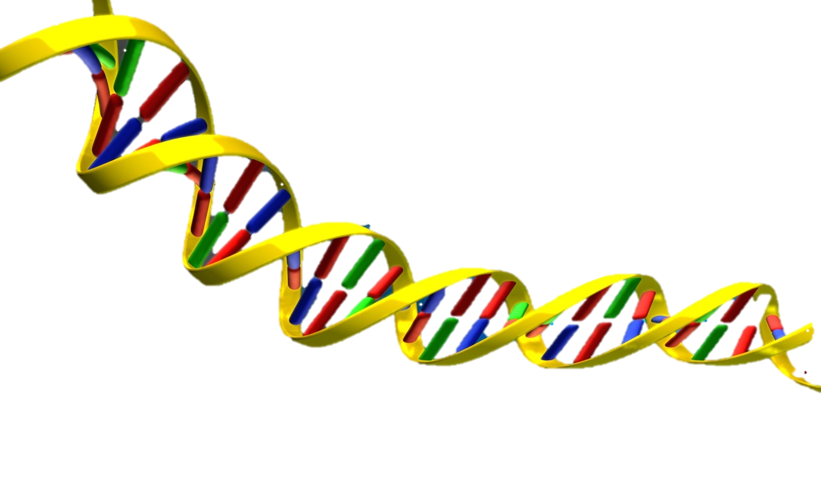
Simplified Hypothetical Example:
Suppose Nicholas’s genotype has a gene sequence that includes the sequence of genes HSP70, BRAF, SRY1, MCM6 means that Nicholas will have blue eyes. The eye color is a phenotype.
Selling your idea
HSP70
BRAF SRY1 MCM6

Slide 5
Example Problem:
With a series of DNA of many species of animals with substrands mapping to various phenotypes, can you create a predictor that decides what phenotypes are actually important for species survival?
Selling your idea

Slide 6
Selling your idea
Gene 1 | Gene 2 | Gene 3 | Gene 4 | Value
ZBTB7 | NPTN | CREBBP | MCM6 | 246
SRY | CRH | KRT14 | GAST | 3947
CREBBP | ZBTB7 | GAST | CRH | 1732
MCM6 | NPTN | KRT14 | SRY | 2329
Gene 1 | Gene 2 | Gene 3 | Gene 4 | Value
BRCA1 | LIF | TSC1 | SDHC | 1041
PHF8 | CFTR | ASPM | OSM | 684
LIF | OSM | CFTR | SDHC | 3475
TSC1 | ASPM | BRCA1 | PHF8 | 978
For instance what would happen if these four gene subsequences all specifically decide the phenotype of wingspan of an animal. For the sake of the experiment, we will assign numbers to each of the sequences so we can see proximity.

Slide 7
Selling your idea
Gene 1 | Gene 2 | Gene 3 | Gene 4 | Value
ZBTB7 | NPTN | CREBBP | MCM6 | 246
SRY | CRH | KRT14 | GAST | 3947
CREBBP | ZBTB7 | GAST | CRH | 1732
MCM6 | NPTN | KRT14 | SRY | 2329
Gene 1 | Gene 2 | Gene 3 | Gene 4 | Value
BRCA1 | LIF | TSC1 | SDHC | 1041
PHF8 | CFTR | ASPM | OSM | 684
LIF | OSM | CFTR | SDHC | 3475
TSC1 | ASPM | BRCA1 | PHF8 | 978
246
ZBTB7 NPTN CREBBP MCM6
1732
CREBBP ZBTB7 GAST CRH
3475
LIF OSM CFTR SDHC
0
1000
2000
3000
4000

Slide 8
Example Problem: In training, we can then assign the labels of “preservation” or “extinction” of a species for each phenotype. For instance for the specific wingspan phenotype,
Selling your idea

Slide 9
Selling your idea
Gene 1 | Gene 2 | Gene 3 | Gene 4 | Value
ZBTB7 | NPTN | CREBBP | MCM6 | 246
SRY | CRH | KRT14 | GAST | 3947
CREBBP | ZBTB7 | GAST | CRH | 1732
MCM6 | NPTN | KRT14 | SRY | 2329
Gene 1 | Gene 2 | Gene 3 | Gene 4 | Value
BRCA1 | LIF | TSC1 | SDHC | 1041
PHF8 | CFTR | ASPM | OSM | 684
LIF | OSM | CFTR | SDHC | 3475
TSC1 | ASPM | BRCA1 | PHF8 | 978
Here are the same datapoints representing a specific type of wingspan. The triangles represent preservation/life and the circles represent extinction/death for the specific species with the gene subsequence.
0
1000
2000
3000
4000

Slide 10
Selling your idea
Gene 1 | Gene 2 | Gene 3 | Gene 4 | Value
HYBA2 | LKJN | ADCD3 | BIST1 | 1381
AVK | YHJ | BHG8 | NVC4 | 2736
ADCD3 | HYBA2 | NVC4 | YHJ | 843
BIST1 | LKJN | BHG8 | AVK | 3992
Gene 1 | Gene 2 | Gene 3 | Gene 4 | Value
ERF | UKJL1 | VRT1 | OJM | 3239
NHT2 | CDWR | YLM1 | PHF5 | 443
VRT1 | ERF | PHF5 | CDRW | 3475
OJM | UKJL1 | YLM1 | NHT2 | 2187
That’s just one phenotype though. An organism has many gene substrands representing different characteristics.
Here is a table of gene substrands that represent a species’ colored stripes on fur. Again, the triangles represent preservation/life and the circles represent extinction/death for the specific species with the gene subsequence.
0
1000
2000
3000
4000

Slide 11
Selling your idea
Gene 1 | Gene 2 | Gene 3 | Gene 4 | Value
ZBTB7 | NPTN | CREBBP | MCM6 | 246
SRY | CRH | KRT14 | GAST | 3947
CREBBP | ZBTB7 | GAST | CRH | 1732
MCM6 | NPTN | KRT14 | SRY | 2329
Gene 1 | Gene 2 | Gene 3 | Gene 4 | Value
BRCA1 | LIF | TSC1 | SDHC | 1041
PHF8 | CFTR | ASPM | OSM | 684
LIF | OSM | CFTR | SDHC | 3475
TSC1 | ASPM | BRCA1 | PHF8 | 978
Going back to the original example of the characteristic of wingspan, if there was a new gene subsequence mapped to the value 2782, we could use k-nearest neighbor with k = 3 to classify if this characteristic predicts preservation/life
Or extinction/death for this species.
?
0
1000
2000
3000
4000

Slide 12
Selling your idea
Gene 1 | Gene 2 | Gene 3 | Gene 4 | Value
ZBTB7 | NPTN | CREBBP | MCM6 | 246
SRY | CRH | KRT14 | GAST | 3947
CREBBP | ZBTB7 | GAST | CRH | 1732
MCM6 | NPTN | KRT14 | SRY | 2329
Gene 1 | Gene 2 | Gene 3 | Gene 4 | Value
BRCA1 | LIF | TSC1 | SDHC | 1041
PHF8 | CFTR | ASPM | OSM | 684
LIF | OSM | CFTR | SDHC | 3475
TSC1 | ASPM | BRCA1 | PHF8 | 978
In this instance of k-nearest neighbors, the point is classified as extinction/death for this characteristic for this species.
0
1000
2000
3000
4000

Slide 13
Example Problem: Of course, every species has a gene sequence with many subsequences dedicated to many many attributes. We can make a good prediction of what characteristics are important with a combination of weighted majority and k-nearest neighbor.
Selling your idea

Slide 14
species | Wing Span | Ommatidia | Incisor Teeth | Fur Stripe Color | Label
Species 1 | Extinction/ Death | Preservation/Life | Preservation/Life | Extinction/Death | Extinction/Death
Selling your idea
Wing Span Ommatidia Incisor Teeth Fur Stripe Color
LIF,SRY,BRCA1,UNM2 CREBBP,MCM6,YRI1,SNM MYH7,PKC,NMN1,BRN MEFV,JRM1,TIF,WRNM
Extinction/Death Preservation/Life Preservation/Life Extinction/Death
Here is an example of a DNA strand with four substrands. Each substrand maps to a specific characteristic. In reality, the DNA strand will be much longer and many more characteristics will be represented. In this example’s case though, the characteristics are “wing span”, “ommatidia”, “incisor teeth” and “fur stripe color”. Notice that each substrand has their own k-nearest neighbor. Also notice that the species itself has a label of “Extinction/Death” on the right.

Slide 15
species | Wing Span | Ommatidia | Incisor Teeth | Fur Stripe Color | Label
Species 1 | Extinction/ Death | Preservation/Life | Preservation/Life | Extinction/Death | Extinction/Death
Selling your idea
Wing Span Ommatidia Incisor Teeth Fur Stripe Color
LIF,SRY,BRCA1,UNM2 CREBBP,MCM6,YRI1,SNM MYH7,PKC,NMN1,BRN MEFV,JRM1,TIF,WRNM
Extinction/Death Preservation/Life Preservation/Life Extinction/Death
Also note that despite the label being “Extinction/Death”, notice that the K-Nearest Neighbors prediction for each characteristic sometimes matches the label and sometimes does not.
Using the weighted majority algorithm, we can downweight the characteristics that don’t seem to match the reality of the species outcome. In other words, if ”Ommatidia” continually predicts a different outcome of the species than the actual label, perhaps “ommatidia” isn’t a very reliable predictor of species survival. Let’s walk through an example.

Slide 16
species | Wing Span | Ommatidia | Incisor Teeth | Fur Stripe Color | Label
Species 1 | Extinction/ Death (1) | Preservation/Life (1) | Preservation/Life (1) | Extinction/Death (1) | Extinction/Death
Selling your idea
Wing Span Ommatidia Incisor Teeth Fur Stripe Color
LIF,SRY,BRCA1,UNM2 CREBBP,MCM6,YRI1,SNM MYH7,PKC,NMN1,BRN MEFV,JRM1,TIF,WRNM
Extinction/Death Preservation/Life Preservation/Life Extinction/Death
All of the characteristics are initialized with the weight of 1.

Slide 17
species | Wing Span | Ommatidia | Incisor Teeth | Fur Stripe Color | Label
Species 1 | Extinction/ Death (1) | Preservation/Life (.5) | Preservation/Life (.5) | Extinction/Death (1) | Extinction/Death
Species 2 | Extinction/ Death(.5) | Extinction/ Death (.25) | Extinction/Death (.25) | Preservation/Life (1) | Preservation/Life
Selling your idea
Wing Span Ommatidia Incisor Teeth Fur Stripe Color
JLR1,AKR,UNM1,BRAF EIF,NRN1,MCM6,YRH HRH1,SGJ,DRF3,BYI CRH2,PNP,LIF,
Extinction/Death Extinction/Death Extinction/Death Preservation/Life
Let’s look at another example. After the second datapoint, it becomes clear that Fur Stripe Color is the most important characteristic thus far.

Slide 18


How many languages do you need to know to communicate with the rest of the world?
Tip
In this example, we’re leading off with something unexpected.
While the audience is trying to come up with a number, we’ll surprise them with the next slide.

Slide 19
species | Gills Big | Gills Small | Ommatidia 10 | Ommatidia 5 | Incisor Teeth Yes | Incisor Teeth No | Skin Color Green | Skin Color Red | Label
Datapoint1 | Death(1) | - | Life(.5) | - | - | Life(.5) | Death(1) | - | Death
Selling your idea
Only penalize the corresponding phenotype.
Death / Big Life / 10 Life / No Death / Green

Slide 20
Selling your idea
Gene 1 | Gene 2 | Gills
BRCA1 | LIF | Big/Death
TSC1 | SDHC | Big/Life
PHF8 | CFTR | Small/Death
ASPM | OSM | Small/Life
Gene 1 | Gene 2 | Ommatidia
ZBTB7A | NPTN | 10/Death
CREBBP | MCM6 | 10/Life
SRY | CRH | 5/Death
KRT14 | GAST | 5/Life
Ommatidia
5 / Death
10 / Death
10 / Life
5 / Life
Gills
Big / Life
Small / Life
Big / Death
Small / Death
Red denotes death
Blue denotes life

Slide 21
Just one! Your own.
(With a little help from your smart phone)
Tip
Remember. If something sounds like common sense, people will ignore it.
Highlight what is unexpected about your topic.

Slide 22
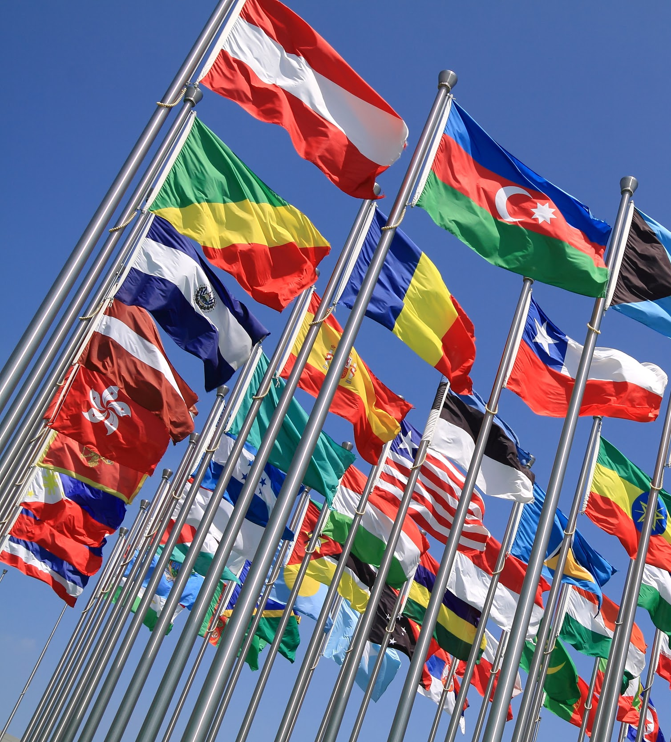
The Google Translate app can repeat anything you say in up to NINETY LANGUAGES from German and Japanese to Czech and Zulu
Tip
Don’t wait till the end of the presentation to give the bottom line.
Reveal your product or idea (in this case a translation app) up front.

Slide 23
2. Examples
By the end of this section, your audience should be able to visualize:
What What is the pain you cure with your solution?
Who Show them a specific person who would benefit from your solution.

Slide 24
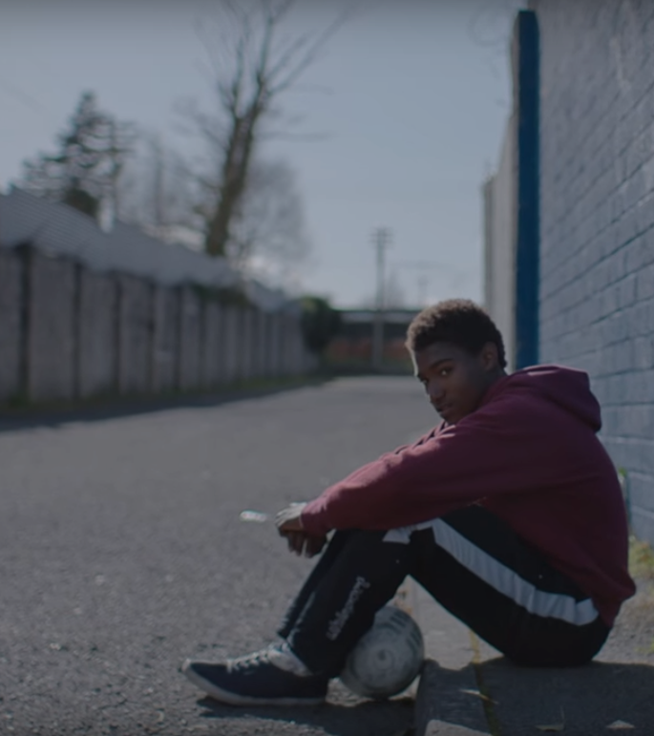
Meet Alberto.
He recently moved from Spain to a small town in Northern Ireland.
He loved soccer, but feared he had no way to talk to a coach or teammates.
Tip
Tell the audience about the problem through a story, ideally a person.

Slide 25

Meet Marcos.
He recently opened a camera shop near the Louvre in Paris.
Visitors to his store, mostly tourists, speak many different languages making anything beyond a simple transaction a challenge.
Tip
If one example isn’t sufficient to help people understand the breadth of your idea, pick a couple of examples.
Story for illustration purposes only

Slide 26

A translation barrier left Alberto feeling lonely and hurt Marco’s business.
Tip
Ideally, speak of people in very different situations, but where each could benefit from your solution.

Slide 27

Then, Marcos discovered Google Translate
He has his visiting customers speak their camera issues into the app.
He’s able to give them a friendly, personalized experience by understanding exactly what they need.

Slide 28
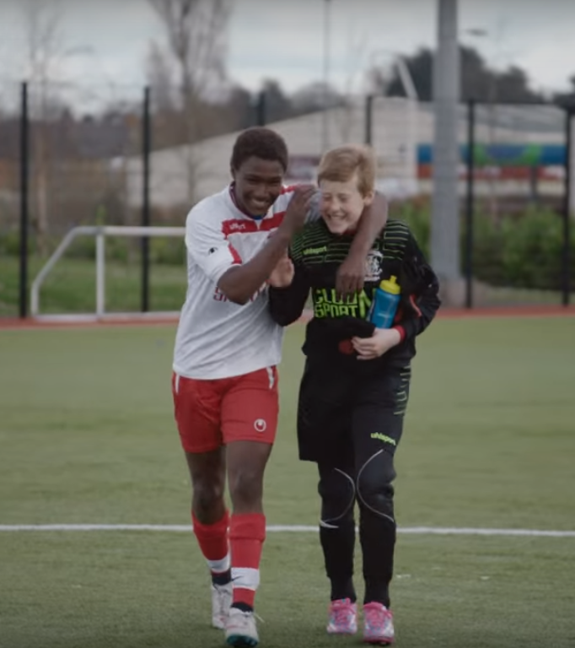
A simple gesture
Coaches Gary and Glen knew no Spanish.
They used Google Translate to invite Alberto to join in... “Do you want to play?”... “Can you defend the left side?”
Tip
Show how your solution helps the person in the story reach his or her goals.

Slide 29

From outsider to star
Alberto scored 30 goals in 21 games. He is now being scouted by several professional clubs in the Premier League. And he’s a favorite of the other boys on the team.
See a short video on Alberto’s story
Tip
Stories become more credible when they use concrete details such as the specific complex moves Alberto learned through Translate and his 30 goals in 21 games performance stats.

Slide 30
3. Examples
People need to understand how rare or frequent your examples are.
Pick 1 or 2 statistics and make them as concrete as possible. Stats are generally not sticky, but here are a few tactics:
Relate Deliver data within the context of a story you’ve already told
Compare Make big numbers digestible by putting them in the context of something familiar

Slide 31
It’s no surprise Marcos uses Google Translate in his shop regularly.
There are 23 officially recognized languages in the EU.
Tip
Don’t let data stand alone. Always relate it back to a story you’ve already told, in this case, Marco’s shop.
Source: theguardian.com

Slide 32


More than 50 million Americans travelled abroad in 2015
THAT’S MORE THAN THE POPULATION OF
CALIFORNIA AND TEXAS COMBINED
Tip
When a number is too large or too small to easily comprehend, clarify it with a comparison to something familiar.
Source: travel.trade.gov

Slide 33
4. Closing
Build confidence around your product or idea by including at least one of the these slides:
Milestones What has been accomplished and what might be left to tackle?
Testimonials Who supports your idea (or doesn’t)?
What’s next? How can the audience get involved or find out more?

Slide 34
Milestones
October 2014
October 2015
August 2015
November 2015
Translate web pages with Chrome extension
Translate text within an app
2014 |  |  |  | 2015
Translate conversations through your Android watch
Translate written text from English or German to Arabic with the click of a camera

Slide 35
What people are saying
With this app, I’m confident to plan a trip to rural Vietnam
Wendy Writer, CA
Visual translation feels like magic
Ronny Reader, NYC
Translate has officially inspired me to learn French
Abby Author, NYC
Quotes for illustration purposes only

Slide 36

Know a 2nd language? Make Google Translate even better by joining the community.
Tip
Inspire your audience to act on the information they just learned.
Depending on your idea, this can be anything from downloading an app to joining an organization.

Slide 37
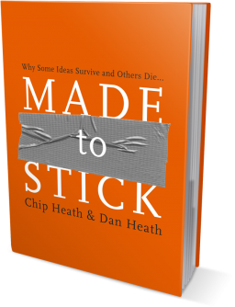
Good luck!
We hope you’ll use these tips to go out and deliver a memorable pitch for your product or service!
For more (free) presentation tips relevant to other types of messages, go to heathbrothers.com/presentations
For more about making your ideas stick with others, check out our book!

